Slide 1
Smart Crowd Management System at “ Almasjed Alharam ”
Presenter : Jawaher Aljulaify – Jamila Alharbi
Instructor: Dr. Mejdal Alqahtani

Slide 2
Table Of Contents
01
02
03
Motivation
Problem definition
Data structure
05
06
Methodology
Conclusion & Future work
04
Objective of project
07
08
Result
Deployment

Slide 3

Motivation
SDAIA and The General Presidency for the Affairs of the Grand Masjid and the Prophet's Masjid harnessing digital products in the service of the guests of the holy places.

Slide 4
Problem definition
we decided to implement a system capable of managing crowds by identifying number of people in crowded places in the holy places to avoid overcrowding accidents.

Slide 5
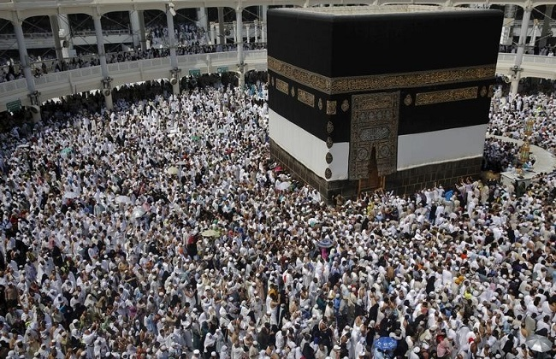
We want to ask you a simple question, what do you think is the most tiring factor for pilgrims?
Of course the crowding !!

Slide 6
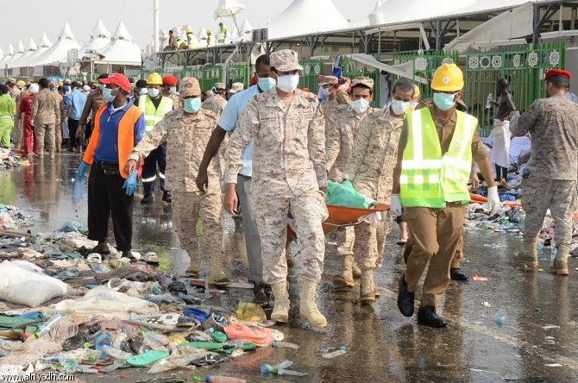
Do you remember what happened in “Mina” in 2015?
Of course, the crowding incident that killed 769 people!!

Slide 7
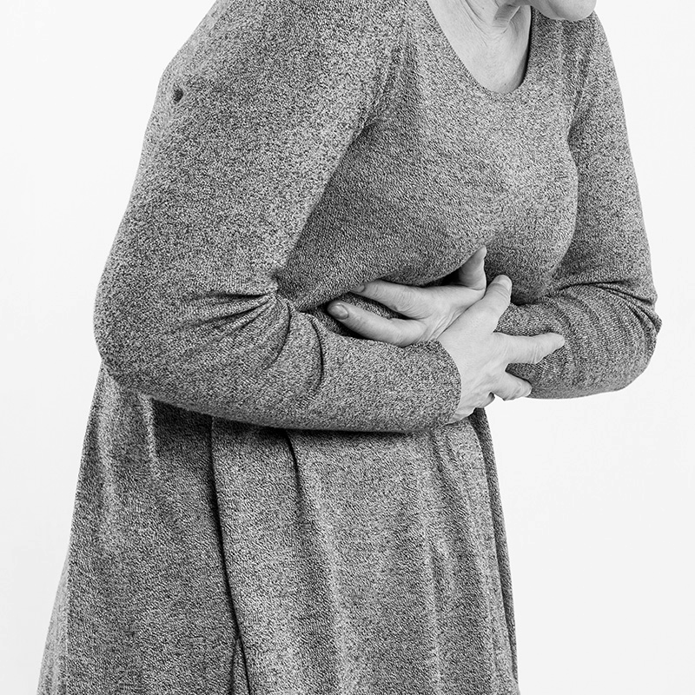
Crowded places damage
respiratory infections
meningococcal disease
rheumatic fever
increase the risk of spread of infectious diseases, such as :
tuberculosis

Slide 8
Objective of this project
1 - Insure the safety of pilgrims .
2 – protect pilgrims from diseases.
3 - facilitate the evacuation process In the event of a stampede or fires.
4 – Make sure the pilgrims will perform the prayers in easy and comfortable conditions.

Slide 9


Sequence of this project
1 - Implementation of the best model capable of counting people
2- Collecting data from Makkah with the help of specialists
3- Training the model on Makkah dataset to be an expert in it

Slide 10
Simple Scenario
Person 1 : number of pilgrims are 1000 Now you can allow some pilgrims to enter.
Person 2 : I let some pilgrims in, tell me about the situation now ?
Person 1 : Now the situation is good, stop entering other pilgrims .

Slide 11
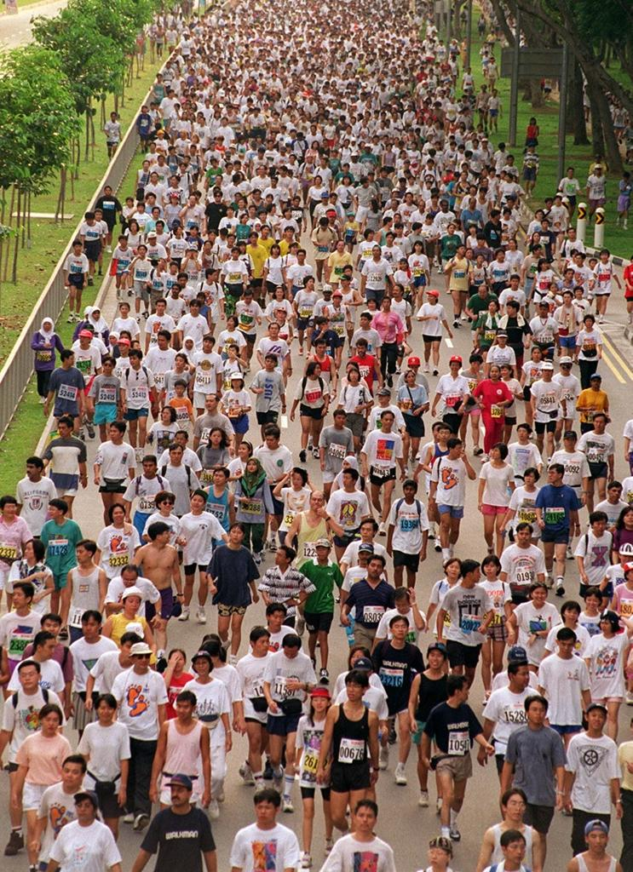
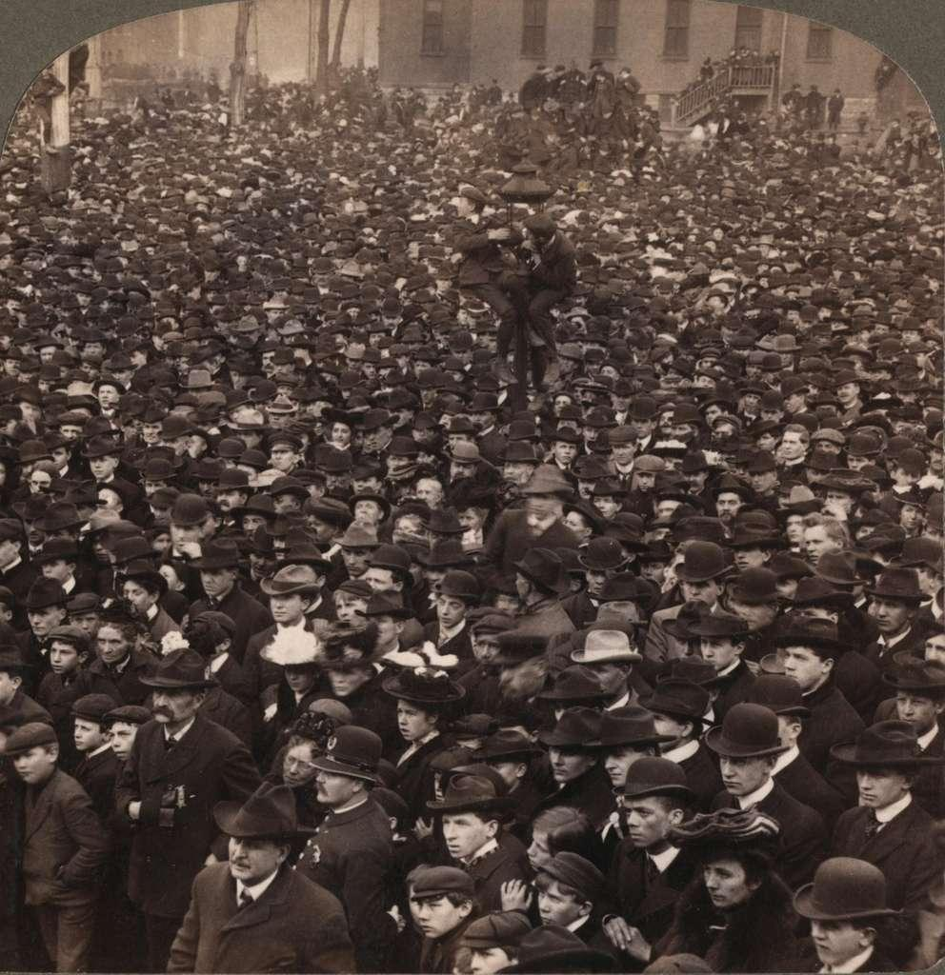
Data structure
Name : shanghai
Type : images
Description : contains pictures from around the world
Number of images : 1198
Example :

Slide 12
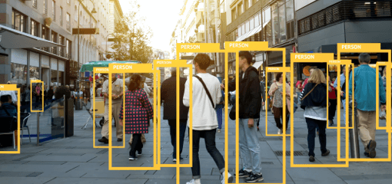
When we use CNN object detection:
The model will Put boxes on people.
But When there are too many people we can't do that …

Slide 13
Methodology
We use CSRNet :
Dilated Convolutional Neural Networks for Understanding the Highly Congested Scenes

Slide 14
We use in our model ( CSRnet) :
Activation function : relu
Pooling layer : MaxPooling
Optimizer : sgd
Loss : Euclidean distance loss
Metrics = MSA (mean squared error )
Epoch = 700

Slide 15
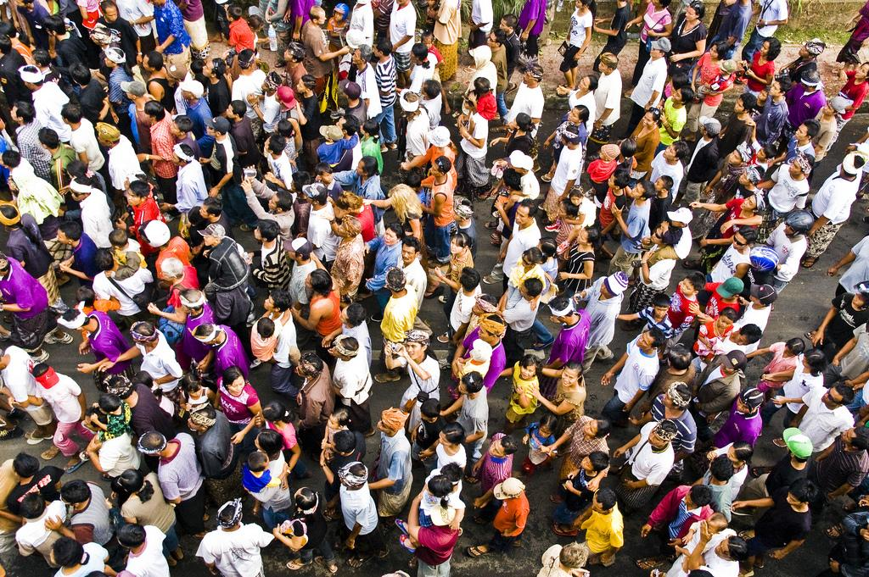
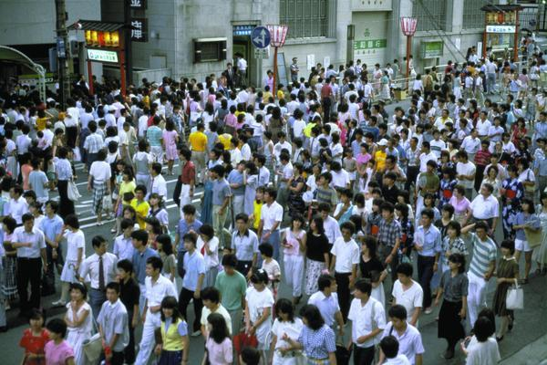
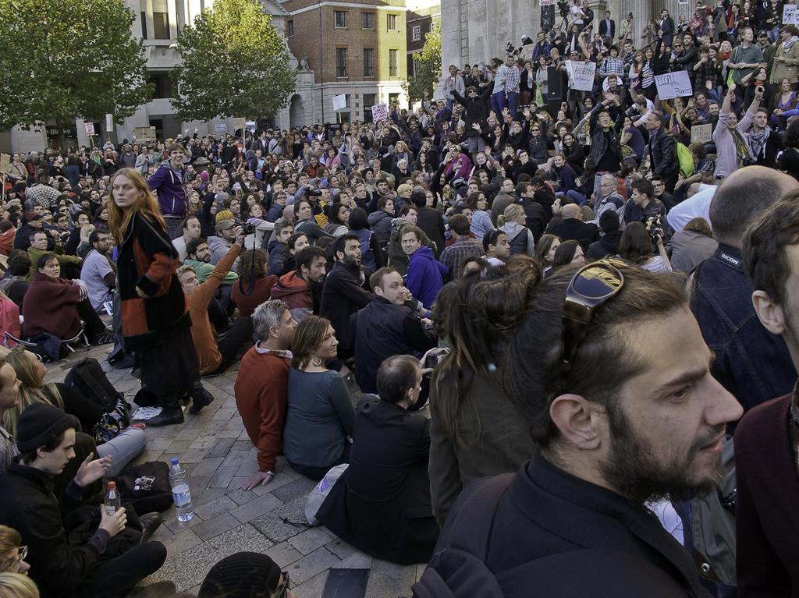
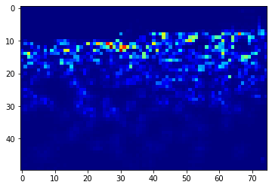
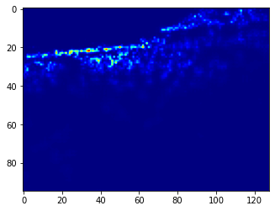
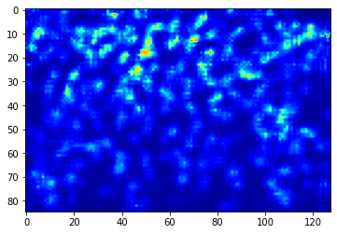
How does our model work?
Predict : 209
True : 212
Predict : 396
True : 393
Predict : 362
True : 361

Slide 16
Result
We use MAE Because it’s more robust to data with outliers.
Validation MAE = 43.378
Test MAE = 65.927

Slide 17
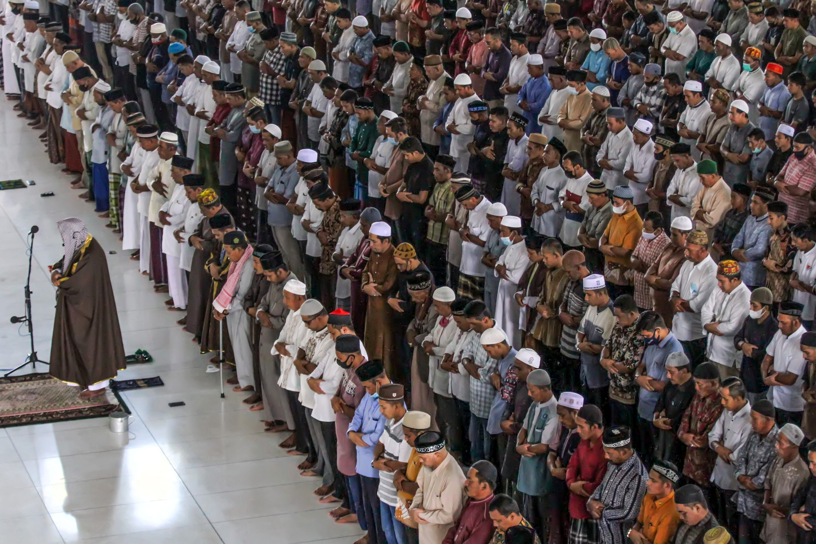
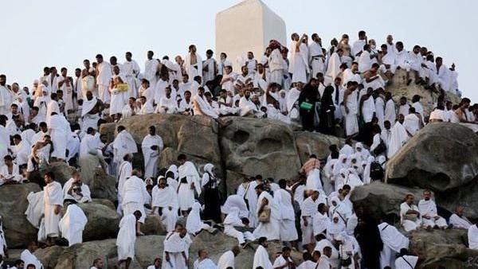
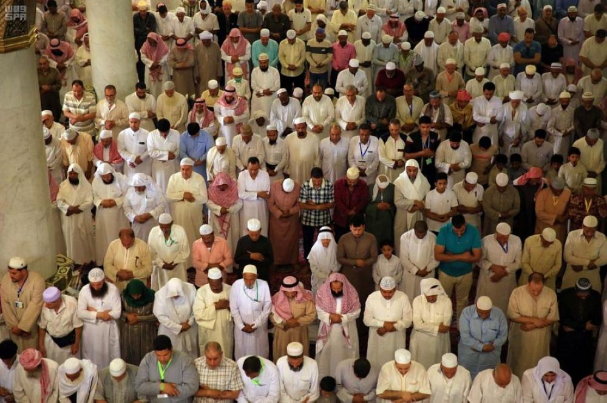
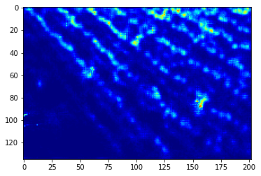
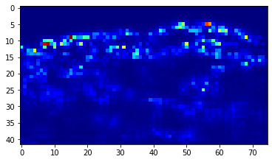
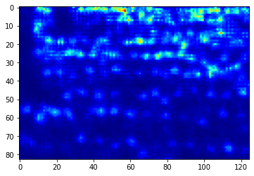
195
163
109

Slide 18
Predict : 109
True : 125

Slide 19
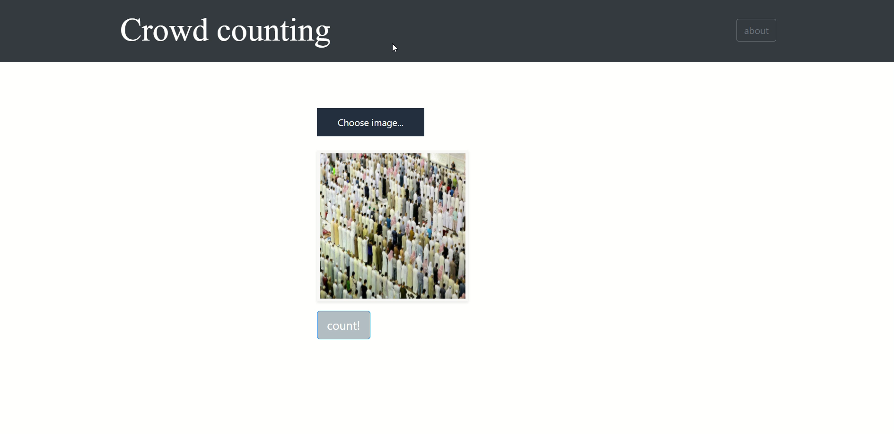
Deployment

Slide 20
Conclusion
We were able to build a model capable of counting people with MAE = 65.927
We completed the first phase of the project with Demo.

Slide 21
Future work
We hope to complete the second and third phases of the project.
We hope that it will be connected to cameras and lamps at the corridors, for example, if they are green, we allow more people to enter. If they are red, entry is prohibited.
We hope to implement it all over the Kingdom of Saudi Arabia.

Slide 22
Thanks
Any questions?

